Slide 1

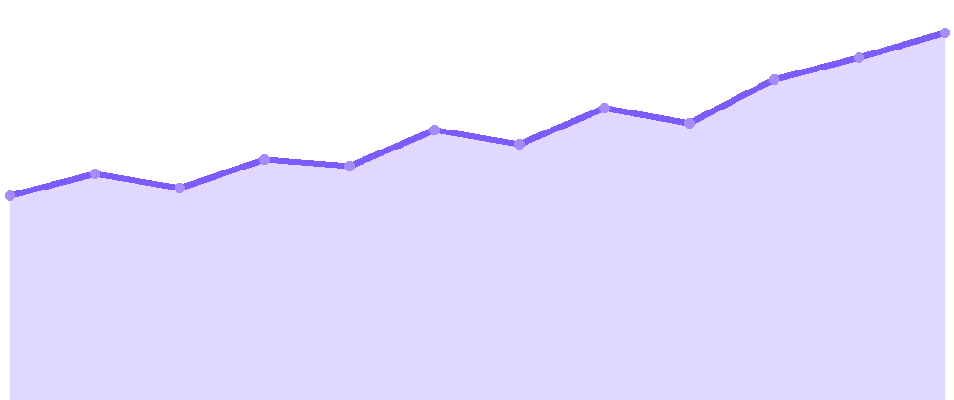
DREAM PAYMENTS
NEW
The 60 Seconds Business Payment Hub.
60 Seconds Payments
● LIVE
60 Seconds
Payouts · Today
PAYMENTS PROCESSED
Real-time ▲ growing
powered by Dream
One platform for 60 Seconds to collect from SMB clients by Interac
e-Transfer Request and pay vendors and employees by EFT and
e-Transfer Payouts, all by API, with built-in KYC and compliance, live in CAD across Canada from launch.
PAID OUT
INTERAC REQ
EFT
Vendor payment
e-TRANSFER
$4,250.00
EFT
TRUSTED BY
JPMorgan
TD Bank
Wave
Mantle
Interac
e-Transfer
RPAA
FINTRAC
COMMERCIAL PROPOSAL
Prepared for 60 Seconds · Attn: Yves Perron · June 2026 · Jonathan Racine, VP Operations & Technology

Slide 2




DREAM PAYMENTS
00 · EXECUTIVE SUMMARY
The 60 Seconds Business Payment Hub.
.
One bidirectional platform: collect from SMB clients, pay vendors and employees, all by API, with every payment KYC-verified, safeguarded, reconciled, and compliant in CAD.
BIDIRECTIONAL
SAFEGUARDED
BILINGUAL
EMBEDDED
Collections In, Payouts Out.
Segregated, Safeguarded Funds.
Built for Quebec and Ontario.
Inside 60 Seconds.
Interac e-Transfer Request collects from SMB clients; EFT and e-Transfer pay vendors and employees.
Client funds held in segregated accounts at a Canadian Tier-1 bank, safeguarded under RPAA.
Quebec and Ontario SMBs served in French and English, with a consistent compliance posture.
COLLECT and SETTLE APIs embed directly into the 60 Seconds platform and flow.
Dream = One Platform. One API. Every Business Payment.
DREAM PAYMENTS · BUSINESS PAYMENT HUB · COMMERCIAL PROPOSAL
02

Slide 3

SECTION I · THE OPPORTUNITY
Vendor and payroll payments at scale.
60 Seconds is building a platform for Canadian SMBs to pay vendors today and employees tomorrow, in a market where low-cost vendor and payroll rails barely exist.
03

Slide 4
DREAM PAYMENTS
01 · THE OPPORTUNITY
60 Seconds is built to scale fast.
60 Seconds is a new venture from an experienced team in the financial space, building a platform for Quebec and Ontario SMBs to pay vendors, with payroll to follow. Targeting launch by end of 2026 with MSB registration in progress, it projects 1,000 to 2,000 clients and rapid transaction growth, exactly the curve that needs embedded payment infrastructure from day one.
2,000
350K
3×
SMB CLIENTS
TXNS / MONTH
WITH PAYROLL
Onboarded by 2027
By end of 2027
Volume multiplier
From 1,000 to 2,000 Quebec and Ontario SMBs, each running 20 to 80 payments a month.
Monthly transaction volume as clients ramp, from a launch base of 20K to 160K.
Adding payroll about six months post-launch roughly triples transaction volume.
Source: 60 Seconds, June 2026.
DREAM PAYMENTS · BUSINESS PAYMENT HUB · COMMERCIAL PROPOSAL
04

Slide 5




DREAM PAYMENTS
02 · THE FIT
Where 60 Seconds + Dream fit together.
60 Seconds owns the SMB and vendor relationships; Dream provides the rails, KYC, compliance, and operations behind them, so payments live inside the platform 60 Seconds is building.
THE MODEL
60 Seconds owns the customer. Dream owns the rails.
What 60 Seconds brings
What Dream brings
SMB and vendor relationships across Quebec and Ontario, bilingual service, with an MSB registration underway.
Interac and EFT rails, KYC and AML, the operations portal, reporting, and reconciliation.
60 Seconds owns the SMB and vendor relationships across Quebec and Ontario.
Dream provides the rails, KYC, compliance, and payment operations.
Together, embedded payments inside the platform 60 Seconds is building.
Go-to-market
A bidirectional platform
Vendor payments for SMBs now, payroll services about six months after launch.
One platform for money in and money out, with room to add payroll, rails, and volume.
DREAM PAYMENTS · BUSINESS PAYMENT HUB · COMMERCIAL PROPOSAL
05

Slide 6
SECTION II · The 60 Seconds Business Payment Hub.
Money in, money out. One API.
Interac e-Transfer Request to collect from SMB clients, EFT and e-Transfer Payouts to pay vendors and employees, with the operations portal, reporting, and reconciliation, all available by API from launch.
06

Slide 7




DREAM PAYMENTS
03 · THE COMPONENTS
Five components. One platform.
The five building blocks that stand the platform up: an operations portal, the Dream API, a segregated bank account, the client funding flow, and the collection and payout rails. Together they cover everything needed to request, collect, pay, and reconcile.
01
02
03
04
05
Operations Portal
The Dream API
Bank Account
Funding Flow
Collection & Payout Rails
Web console for onboarding, funding, payment initiation, and reconciliation. Role-based access for finance and ops.
REST. JSON. Idempotent. HMAC-signed webhooks. Sandbox provisioned the same day you sign.
Held at a Canadian Tier-1 bank. Segregated by client. Inbound and outbound on the same account.
Branded Interac e-Transfer Request by email and secure web. Clients fund and get instant confirmation.
Interac e-Transfer Request to collect, EFT and e-Transfer to pay out. Canada. One API.
Built for speed.
< 30 min
T + 1
99.99%
INTERAC REQUEST
EFT SETTLEMENT
UPTIME SLA
DREAM PAYMENTS · BUSINESS PAYMENT HUB · COMMERCIAL PROPOSAL
07

Slide 8





DREAM PAYMENTS
04 · HOW IT WORKS
From request to reconciled settlement.
How a single payment moves end to end: 60 Seconds issues an Interac e-Transfer Request, the client funds, Dream validates and reconciles the money, then pays the vendor or employee by EFT or e-Transfer. Every step is tracked, so money in always ties back to money out.
STEP 01
STEP 02
STEP 03
STEP 04
Request
Fund
Reconcile
Pay out
EFT or Interac e-Transfer Request issued to the SMB client via API
The client funds from their bank in a frictionless flow
Auto-matched and reported in the operations portal
EFT or e-Transfer out to the vendor or employee
Payors SMB clients Payees vendors and employees
DREAM PAYMENTS · BUSINESS PAYMENT HUB · COMMERCIAL PROPOSAL
08

Slide 9









DREAM PAYMENTS
05 · ARCHITECTURE
The architecture, top to bottom.
This is the full stack, from the businesses who pay down to the rails that move the money. It shows exactly where the SMB clients, the 60 Seconds platform, the Dream API, and each rail sit, so what 60 Seconds touches and what Dream runs underneath is clear.
LAYER 01
SMBs · Businesses · Clients
Who pays
They interact only with the 60 Seconds experience.
▾
LAYER 02
60 Seconds Platform
60 Seconds
The branded front-end where businesses initiate payments.
▾
LAYER 03
THE DREAM API embedded into the 60 Seconds platform · COLLECT + SETTLE
Dream API
▾
LAYER 04
COLLECTIONS · from clients
PAYOUTS · to vendors & employees
DreamPay
Request
Validate
Reconcile
Aggregate
Settle
Report
Issue e-Transfer Request
KYC, AML, screening
Match funds to source
Batch by payee
EFT and e-Transfer out
Files and confirmations
COLLECTION RAILS
▾
PAYOUT RAILS
LAYER 05
The rails
e-Transfer Request
EFT
EFT
e-Transfer Payouts
Vendors & employees
DREAM PAYMENTS · BUSINESS PAYMENT HUB · COMMERCIAL PROPOSAL
09

Slide 10



DREAM PAYMENTS
06 · CAPABILITIES
Everything to pay at scale.
60 Seconds plugs into Dream's rails, compliance stack, and operations console through one API. Collections, payouts, KYC, verification, reconciliation, and reporting all run from the same place, so the platform can scale volume without adding headcount or vendors.
FAST
EMBEDDED
COMPLIANT
Multi-rail money movement
API-first integration
Bank-grade security
EFT and Interac e-Transfer Request to collect, EFT and e-Transfer Payouts to pay vendors and employees.
COLLECT and SETTLE APIs embed directly into the 60 Seconds flow, with an operations portal for ops.
PCI-DSS, SOC 2, FINTRAC MSB, and Bank of Canada RPAA. Dream handles KYC, AML, and monitoring.
DREAM PAYMENTS · BUSINESS PAYMENT HUB · COMMERCIAL PROPOSAL
10

Slide 11
SECTION IV · THE COMMERCIALS
Simple, transparent, volume-scaled.
A monthly platform fee from the moment sandbox access is granted, flat per-transaction rates by rail, volume-tiered discounts, and optional value-added services, with no setup fee. All amounts in CAD, domestic Canada.
14

Slide 12
DREAM PAYMENTS
09 · PRICING
Simple, usage-based pricing.
Three simple components: a monthly platform fee that begins when sandbox access is granted, flat per-transaction rates by rail, and optional value-added services. Rates step down as monthly volume grows, with no setup fee. All amounts in CAD, domestic Canada.
PLATFORM · MONTHLY
VOLUME · TIERS
$950 / month
-10% / -20%
Begins when sandbox access is granted.
-10% over 10K/mo, a further -10% over 50K/mo.
PER-TRANSACTION
e-Transfer, request & payout
$1.00 / txn
EFT, vendor & payroll payout
$0.50 / txn
VALUE-ADDED SERVICES
Account verification, per new account
$1.50 / acct
KYC, onboarding & monitoring
Scoped
All amounts in CAD, domestic Canada. The platform fee begins when sandbox access is granted, then bills monthly on top of transaction and service fees. Per-transaction rates step down 10% above 10K/month and a further 10% above 50K/month. KYC pricing is scoped to the use case. No setup or onboarding fee.
DREAM PAYMENTS · BUSINESS PAYMENT HUB · COMMERCIAL PROPOSAL
15

Slide 13
DREAM PAYMENTS
10 · PATH TO ACTIVATION
A clear path to activation.
A clear, three-step path from a signed agreement to a live, scaling platform: commercials and sandbox access, then build and QA, then launch and scale. Each step has a defined owner and outcome, so 60 Seconds can go from decision to first live payment in weeks.
01
02
03
COMMERCIALS
BUILD
GO LIVE
Agreement & announcement
Implementation & QA
Launch & scale
Finalize commercial terms and grant sandbox access to begin building.
Integrate the COLLECT and SETTLE APIs, configure the operations portal, and run end-to-end QA and certification.
Go live on vendor payouts by end of 2026, then add payroll services about six months later as volume scales.
DREAM PAYMENTS · BUSINESS PAYMENT HUB · COMMERCIAL PROPOSAL
16

